Slide 1
A Practical Approach to Timeseries Forecasting using Python
Project 2: Microsoft Corporation Stock Prediction using RNNs
Data Analysis
Stationarity Check
Deployment of LSTM, Stacked LSTM, BiLSTM and Stacked BiLSTM
Performance Comparison
Shahzaib Hamid

Slide 2
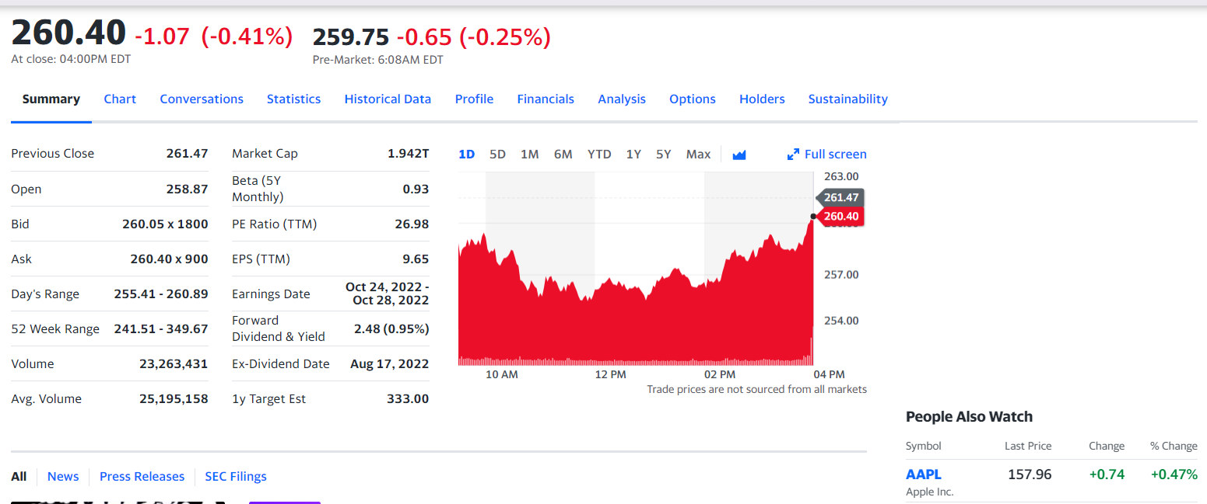
Data Overview
Microsoft Corporation Stocks Dataset

Slide 3
Project Flow
Step 1: Import Dataset
Step 2: Perform Data Analysis
Step 3: Perform Data Visualization
Step 4: Compute and Visualize Autocorrelation, Mean, and Standard Deviation
Step 5: Stationarity Check
Step 6: Implementation LSTM
Step 7: Implementation Stacked LSTM
Step 8: Implementation of BiLSTM
Step 9: Implementation of Stacked BiLSTM
Step 7: Performance Comparison

